Slide 1
Electrical Safety-Review
Introduction
V Semester (A & B Sections)

Slide 2
Introduction
Engineering safety is an Interdisciplinary branch Subject, with courses titles
Safety Engineering (Petroleum Engineering Dept)
Engineering Safety
M.Tech in Electrical Safety

Slide 3
Safety
Engineering
Electrical and Electronics
Mechanical
Computer
Civil

Slide 4
Arc
Controlled Process
Uncontrolled Process
Blast
Uncontrolled Process
Causes and Effects
Shock
Uncontrolled Process
Causes and Effects
Causes and Effects

Slide 5
Electric Arc
Welding
Circuit Breaker
Fuse
Home/Industry

Slide 6
Electrical Blast
High Voltage
High Pressure
High Current
Mechanical effects

Slide 7
Electrical Shock
Nervous System
Muscular
Burns
Skin

Slide 8
Engineering Systems
Modelling
Analysis
Design

Slide 9
Analysis of Electrical Energy Conversion process
Input Energy
Electrical Equipment
Output Energy
Voltage/Current
Electrical Motor
Speed/Torque
Disturbance
Control System Transfer function
Desired Response

Slide 10
Electrical & Electronics Engineering
Electrical Safety
Raw Materials/
Planning
Design/
Manufacturing/Production
Monitoring/
Maintenance
Operation and Control

Slide 11
Basic Electrical components and Appliances
Electrical Resistor
Filament lamp
Electric toaster
Inductor
Transformer
Magnetic circuits
Capacitor
Reactive power supply
Storage Device

Slide 12
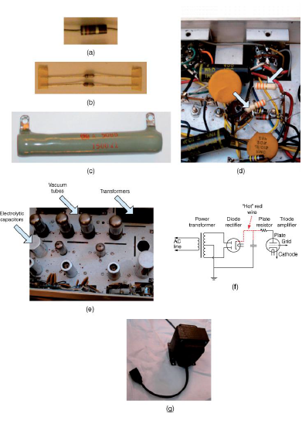
Resistors used as electronic components.
(a) Carbon composition resistor, axial lead, ½ W, 470 W, 10% tolerance.
(b) Carbon film, axial lead, 1/4 Watt, 10 kW, 5% tolerance.
(c) Vitreous enamel-coated wire-wound power resistor, 1500 W. (d) Plate resistors in vacuum tube amplifier.
(e) Vacuum tube amplifier where plate resistors would be used.
(f) Schematic of vacuum tube amplifier where plate resistors would be used.
(g) Isolation transformer (115 V, 250 VA) for servicing “transformerless” electronic equipment.

Slide 13
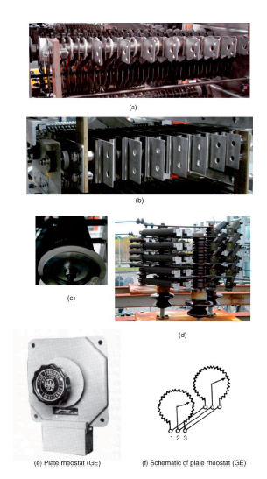
Resistors used in electric power
systems.
Plate resistor.
Ribbon resistor.
(c) Noninductive resistor.
(d) Ribbon-wound
resistor.
(e) Plate rheostat (GE).
(f) Schematic
of plate rheostat (GE).

Slide 14
Applications of Plate rheostats
Speed control of dc motors. Use rheostat to control field excitation.
Power-factor control of synchronous motors. Use rheostat to control field excitation.
Voltage control of generators and exciters. Use rheostat to control field excitation.
Adjustment of voltage in control circuits. Use rheostat to vary impressed voltage.
Speed control of wound-rotor motors. Use rheostat to vary resistance in motor secondary; not over 15 HP.

Slide 15
safety hazards with plate rheostats
Exposure to high voltages at rheostat terminals;
Burns from coming in contact with heated plates.

Slide 16
Heating
Copper, Nicrome, Iron
electric toaster, stove, oven, space heater using Iron Wire
Lighting
Filament Lamp
Tungsten Lamp
Problems
Short circuit leads to Arc
Loose/poor Connections leads to Heating

Slide 17
Overcome-Observe
Problems in Electrical Appliances made of Resistance
Infrared Thermometers
Fuses
Transmission Lines C.Bs

Slide 18
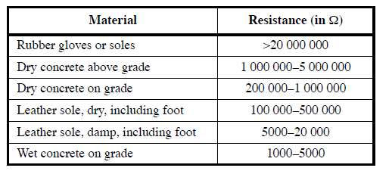
Resistance values for 130 cm² areas of various materials

Slide 19
Ohmic Conductivity of Some Common Materials (at Room Temperature)
Material | σ (S/m)
Pure Water | 4×10⁻⁶
Carbon | 7.3×10⁻⁴
Sea Water | 4
Lead | 0.5×10⁷
Tin | 0.9×10⁷
Zinc | 1.7×10⁷
Gold | 4.2×10⁷
Pure Copper | 5.9×10⁷
Silver | 6.3×10⁷
Aluminum | 2.7×10⁸

Slide 20
Good reasons for practicing electrical safety
Personal & Business
Regulatory
& Legal
Practicing electrical safety

Slide 21
Arc Energy is a function of several variables
Arc Energy
Arc Voltage Drop
Arching Current
Length of the Arc
Gap between the Conductors

Slide 22
Overcome the Arc Energy
Incident Energy
Heat Energy Received by the Body
Risk Analysis/
Protective Equipments

Slide 23
Resistance Relations
Where G = 1/R = Conductance in Siemens
Where conductivity in Siemens/m
Point form of Ohms Law

Slide 24
Electrical Safe maintenance/ operation/control of power system equipments/components
Voltage Sensors
Current sensors
Frequency sensors

Slide 25
Measurement of voltage, current and frequency
Safe operation of Generating stations
Safe operation of transmission networks with Lightning flash over faults
Safe clearance of faults and protect power transformers using C.Bs with relays
Safe operation and maintenance of distribution systems

